Slide 1
Arrays

Slide 2
What is an array
Arrays are containers for data of different dimensions and shapes
Subtle differences between mathematical arrays and numpy arrays
  Math arrays have specific properties numpy arrays do not
Building blocks of much of quantitative analysis

Slide 3
Array shapes and dimensions
Dimensions = Number of groups of elements
Shape = number of elements in each dimension or group
  1-dimensional array -> One shape value
  2-dimensional array -> Two shape values

Slide 4
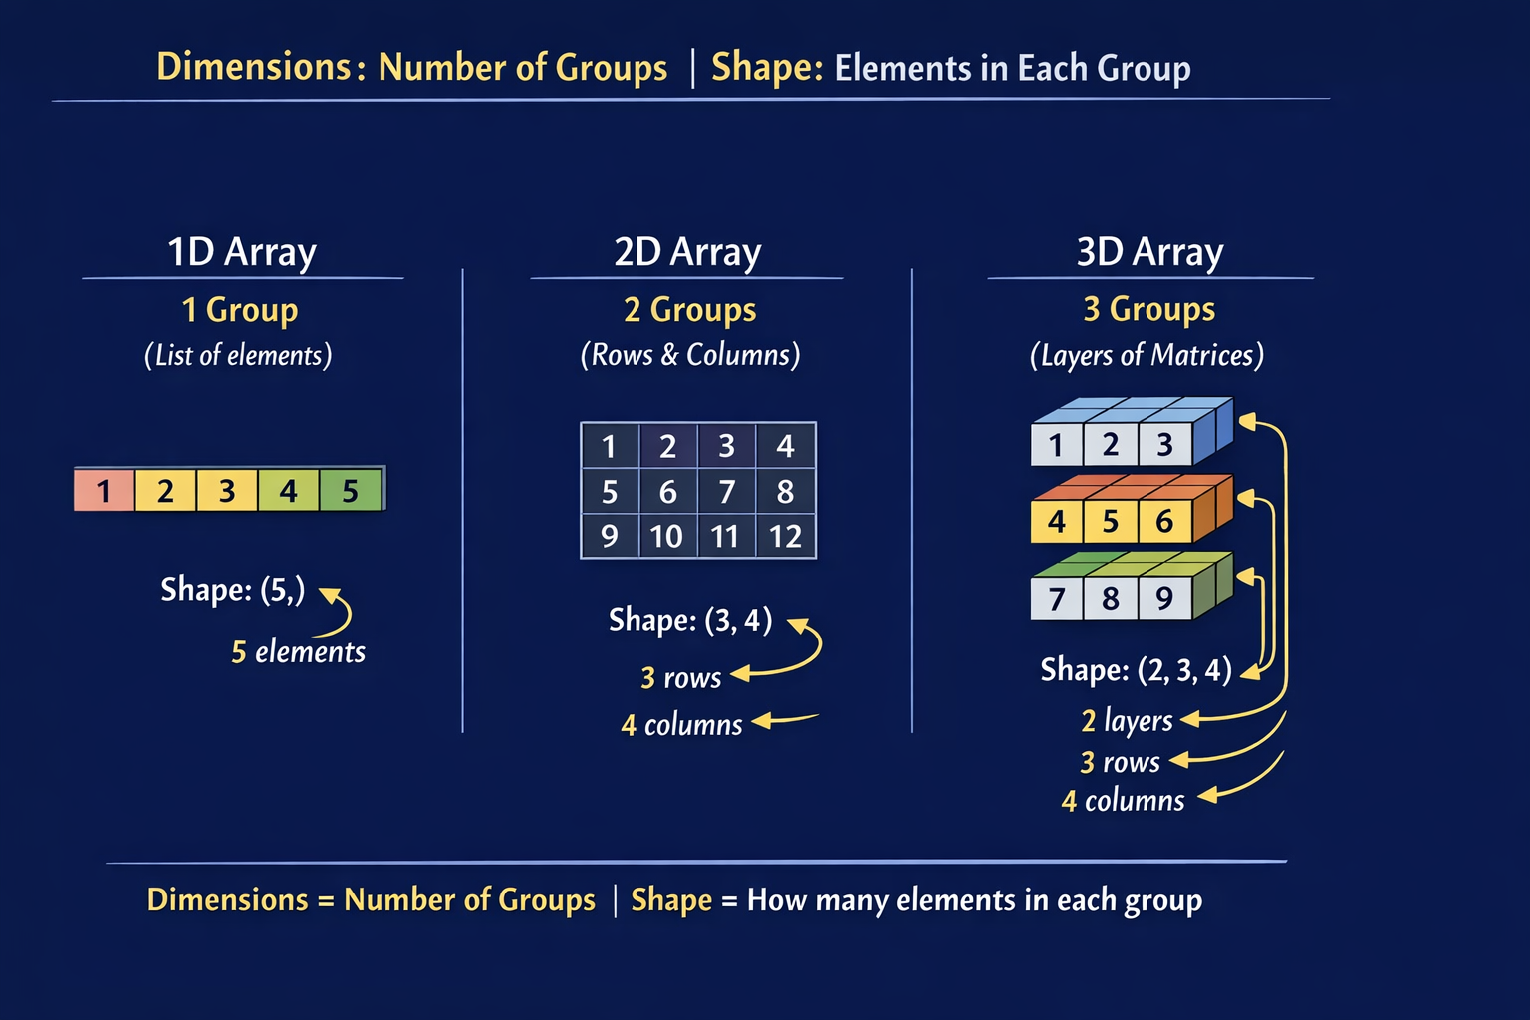

Slide 5
Array types
Vector = 1-dimensional array
Matrix = 2-dimensional array
Tensor = 3-dimensional or higher array
Scalars = single numeric values

Slide 6
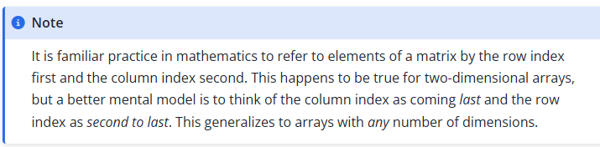
Rows and columns
With matrices, rows always listed first, then columns
  Rows = observations
  Columns = variables
Real-world memory aids
  Event seating: Row 11, seat 23
  Apartments: Floor as Row, Apt # as column

Slide 7
Rows and columns, again
Unlike real world examples, no semantic meaning to rows and columns
Matrix: 5,23
  Assume row 5 and seat 23
  Transpose value: 23,5
  Assume row 23, 5
Dataframe: Labels explicit
  Row 5, Seat 23
  Transposed: Seat 23, Row 5

Slide 8

Array importance
Matrices: Linear regression
  $\hat{β}={\left(X^{′}X\right)}^{−1}X^{′}y$
Tensors:
  Word/sentence embeddings
  Images

Slide 9
Vector
One dimensional array
array([0,1,2,3])
Shape = number of elements
  Here, 4

Slide 10
Matrices
Two-dimensional arrays (np.ndim()==2)
Np.shape(matrix) = (2,3)
First value always refers to rows
Second value always refers to columns
Building blocks of data frames

Slide 11
Tensors
3 or more dimensions
Word or sentence embeddings as example

Slide 12
Arrays v. dataframes
Arrays
  Multidimensional
  Same data types
  Index only
  Smaller size
  Rows/columnshave no intrinsic meaning
Dataframes
  Two-dimensional
  Different data types
  Index or row/column name
  Larger size
  Rows/columns labeled

Slide 13
Matrix operations
Addition
Subtraction
Division
Multiplication

Slide 14
Element by element
Arrays have same shape
[0,1,2,3] + [4,5,6,7] = [0+4,1+5,2+6,3+7] = [4,6,8,10]
[0,1,2,3] - [4,5,6,7] = [0-4,1-5,2-6,3-7] = [-4,-4,-4,-4]
[0,1,2,3] * [4,5,6,7] = [0*4, 1*5,2*6,3*7] = [0,5,12,21]

Slide 15
Matrix multiplication
Inner product of two arrays
Shapes have to be the same
With vectors, same number of elements
With matrices, columns of matrix 1 same as rows of matrix 2
Resulting matrix shape = rows of matrix 2, columns of matrix 2
(3R,2C) * (2R,3C) = (3R,3C)
(2R,3C)*(3R,2C) = ?

Slide 16
Example
Matrix multiplication
Inner dimensions have to be the same
  arr2 = np.array([[10, 20, 30], [5, 10, 15], [1, 1, 1]])
  arr4 = np.array([[1, 3, 5], [7, 9, 11]])
arr2 * arr4 : ERROR
arr4 * arr2 : ERROR
Arr2 @ arr4 : ERROR
arr4@arr2 : (2,3)*(3,3) = (2,3) array
Array([[30,55,80],[126,241,356]])

Slide 17
[30,55,80]
[1, 3, 5] * [10,5,1] = 1*10 + 3*15 + 5*1 = 30
[1, 3, 5] * [20,10,1] = 1*20 + 3*10 + 5*1 = 55
[1, 3, 5] * [30,15,1] = 1*30 + 3*15 + 5*1 = 80

Slide 18
Matrix operations
Transpose: Swapping rows and columns
  arr2 = np.array([[10, 20, 30], [5, 10, 15], [1, 1, 1]])
  arr2.T = array([[10,5,1],[20,10,1],[30,15,1]])
Similar in spirit to dataframe pivot or melt
Swap columns and rows
  Wide to long – columns become observations
  Long to wide – observations become columns

Slide 19
Useful matrix functions
Identity matrix
  Diagonal elements = 1
  Off-diagonal = 0
  array([[1,0,0],]0,1,0],[0,0,1]])
Ones vector
  All values = 1
Zeros vector
  All values = 0

